Slide 1
Statistical Analysis of Predicting the Outcomes of American Football Games
Springboard Introduction to Data Science Capstone Project
Derek J. Dennis
May 2018

Slide 2
Problem
Sports gambling is a 90 billion dollar enterprise.
Potential bettors are always looking for that “edge” to maximize their profits
Predicting the outcome of these games is very difficult to do on a consistent basis. There are too many variables to consider (injuries, strength of schedule, weather, etc…) in order to be consistently excellent.

Slide 3
Opportunity
If a simple algorithm could correctly predict the outcome of a game on a consistent basis, potential bettors would be interested in paying for this information as it would become a perceived “edge” against the oddsmakers.
This algorithm would take into account as few variables as possible while still having success at predicting game outcomes.

Slide 4
Can a rating system be developed to predict the outcomes of college football games?
Either by using an oddsmaker spread or by their Over/Under prediction?

Slide 5
Data Obtained for the Dataset Using all Division 1-A College Games from 2010-17
The teams playing
The scores of the games
Whether the game was played at a neutral site or not
The time of game (year, week)
Proprietary ratings (utilizes various football statistics
ESPN.com
ESPN.com
Ncaasports.com
ESPN.com
Cfbstats.com, ncaasports.com

Slide 6
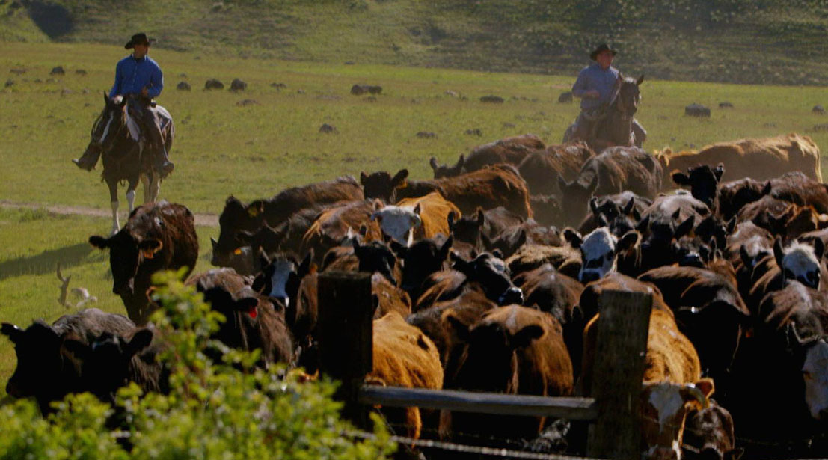
Data Wrangling
Thankfully, there was not much tidying up to do with the data.
The game score was in a dashed format, so it needed to be split out to do calculations.
Scores like 17-10 were separated so 17 and 10 were in separate columns without the dash.
Various columns would need to be added to house the calculations and predictions going forward.

Slide 7
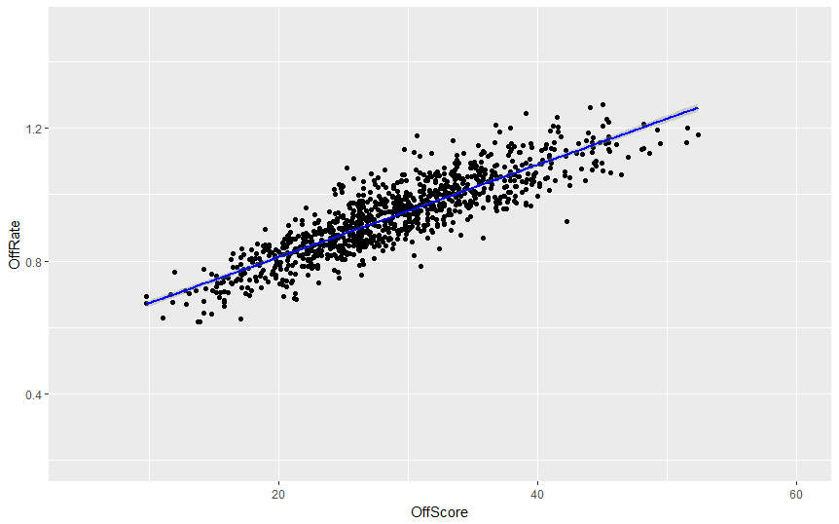
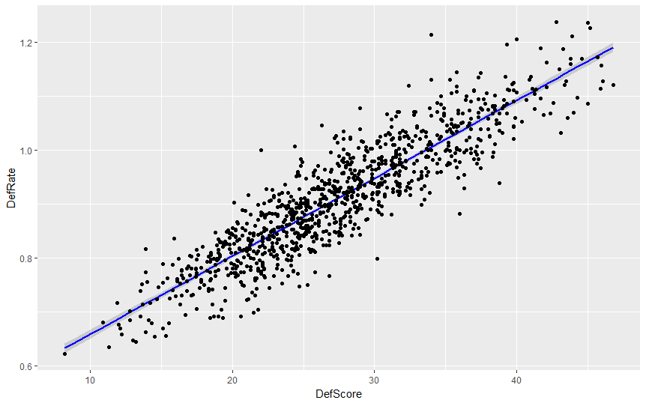
Statistical Analysis
To see if the proprietary ratings would be a viable candidate to predict outcomes, a linear regression was developed with the offensive and defensive ratings (dependent variable) compared against the points per game (independent variable) for each team in the eight years of analysis.
The R-squared calculation, which shows the correlation between the variables, had values of 0.77 and 0.81 respectively. This shows good correlation between the variables
Line equation:
y = 0.0139x + 0.5323
Line equation:
y = 0.0144x + 0.5149

Slide 8
Types of Wagers to be Analyzed
Spread - This is a handicap that oddsmakers give stronger teams to “level the playing field” and make an even bet. For example, if Team A is favored by 10 points against Team B, to win a Team A bet, they would have to win by 11 points or more.
Over/Under – This is a predictive number that oddsmakers give as the total amount of points both teams will score in the game. The bettor would then choose whether she thinks the two teams will score more points than the prediction (over) or less points (under).

Slide 9
Main Goal of the Analysis
It would be intuitive that the rate of success in predicting games would be more than 50% since the choice is between two teams with a theoretical equal chance of winning against the spread.
In reality, the benchmark number for success rate is 52.4%.
The extra 2.4% is a result of what people in betting circles call the “juice”.
When a wager is correct, the betting establishment takes a percentage of the winnings (the juice).
By winning a $10 bet, the bettor only receives $19.10 instead of $20.
($10 original bet + $10 win – juice).

Slide 10
Tests to Be Performed
Analysis of entire data set against the spread – Compare the spread against the difference of the two teams’ offensive rankings + defensive rankings x 100 in each game. If the number is less than the spread, the prediction will be for the home team. If it is more, the prediction will be for the away team.
Same test using regression – Convert all of the proprietary ratings to scores by using the average of the two linear regression lines (y = 0.0139x + 0.5323 and y= 0.0144x + 0.5149). Therefore, the equation to predict score would be: SCORE = (0.01415 * Rating) + 0.5236.
Add the differences of the two new offensive scores and defensive scores to compare against the spread.
Yearly Consistency Test – Determine if the final output determined in test one is consistent over the course of eight years.

Slide 11
Tests to Be Performed
Season Quarterly Analysis – Determine if the calculation works better in the beginning, middle or end of the season by breaking up all of the data into quarters.
Home Team-Away Team/Favorite Underdog – Break up the data into five groups: Home Favorite, Home Underdog, Away Favorite, Away Underdog, Neutral Field to see if there are some trends in that data.
Regression test on Over/Under—Perform predictive regression analysis on the ratings to create predicted scores for each team and use them to predict the outcome of Over/Under wagers.

Slide 12
Results
Test | Subtest | Wins | Losses | % Success
Data Set – Spread |  | 2892 | 2702 | 51.7
Regression – Spread |  | 2892 | 2702 | 51.7
Year | 2010 | 349 | 321 | 52.1
 | 2011 | 335 | 338 | 49.8
 | 2012 | 362 | 322 | 52.9
 | 2013 | 368 | 322 | 53.3
 | 2014 | 370 | 346 | 51.7
 | 2015 | 386 | 331 | 53.8
 | 2016 | 348 | 367 | 48.6
 | 2017 | 378 | 351 | 51.9

Slide 13
Results
Test | Subtest | Wins | Losses | % Success
Quarter Data | 1st Quarter | 798 | 748 | 51.6
 | 2nd Quarter | 852 | 857 | 49.9
 | 3rd Quarter | 957 | 822 | 53.8
 | 4th Quarter | 289 | 271 | 51.6
Home-Away/Fav-Dog | Home Favorite | 898 | 930 | 49.1
 | Home Underdog | 256 | 235 | 52.1
 | Away Favorite | 852 | 771 | 52.5
 | Away Underdog | 860 | 750 | 53.4
 | Neutral Site | 209 | 109 | 52.4
Over-Under w/ Regression |  | 1460 | 1527 | 48.9

Slide 14
Recommendations
On the whole, the proprietary ratings system cannot be trusted over the span of an entire season. However, there were some areas where the formula appeared to have interesting results:
During weeks 10-13 of the regular season the success rate was at its highest – 53.8% This makes sense as there is more performance data. The 4th quarter was artificially low because the last week of any season historically performed poorly. The bowl season, which is included in the 4th quarter results, actually performed at a 53.1% rate.
Picking the away team seems to have some statistical significance. Predicting the away team was correct 52.9% of the time while the home team was only correct 50%. This could be due to oddsmakers skewing the line towards the home team by giving them an average of three extra points in the line. The rankings do not reflect that.
In these situations, the formula can be used to get a positive outcome.

Slide 15
Learnings
Clearly, the formula needs some work as most of the tests performed at or below the 52.4% threshold. Things to look at in the future:
By adding points in the analysis to favor the home team, will this change the data in order to pick more home teams correctly while still having a successful percentage by picking away teams as well?
The regression model as a predictor of points scored doesn’t work very well in the spread or as a bet for Over/Under. Obviously, the formulas do not take into account schedule strength, injuries or weather. Is there away to refine some data to add in these variables without over complicating the system?
Is there a way to analyze that proprietary formula and its weighting system to see if it has an effect on the predictions?

Slide 16
Questions?

